Slide 1

Finding & Getting Data
WQD7001

Slide 2
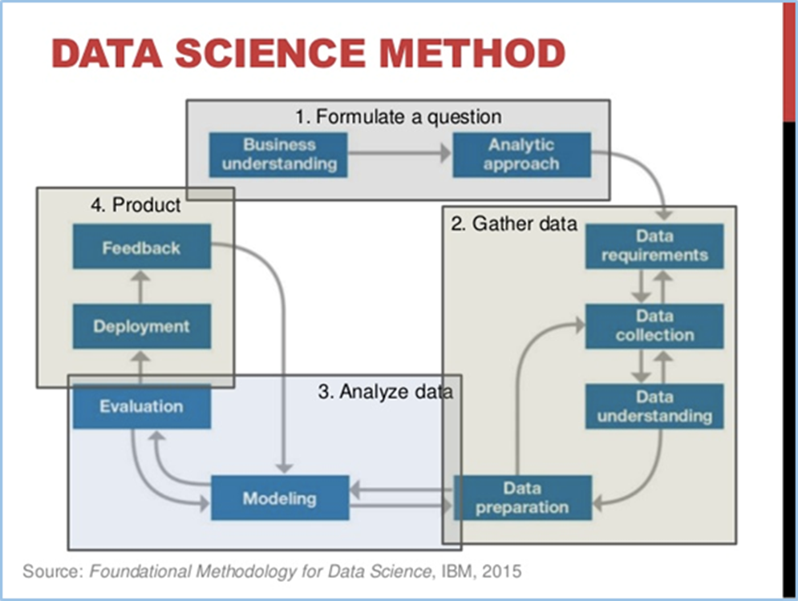
The Data
The most important thing in data science is the question.
The second most important thing is the data.
Often the data will limit or enable the questions.
But having data cannot save you if you do not have a question.
Data
• Data are values of qualitative or quantitative variables, belonging to a set of items.

Slide 3
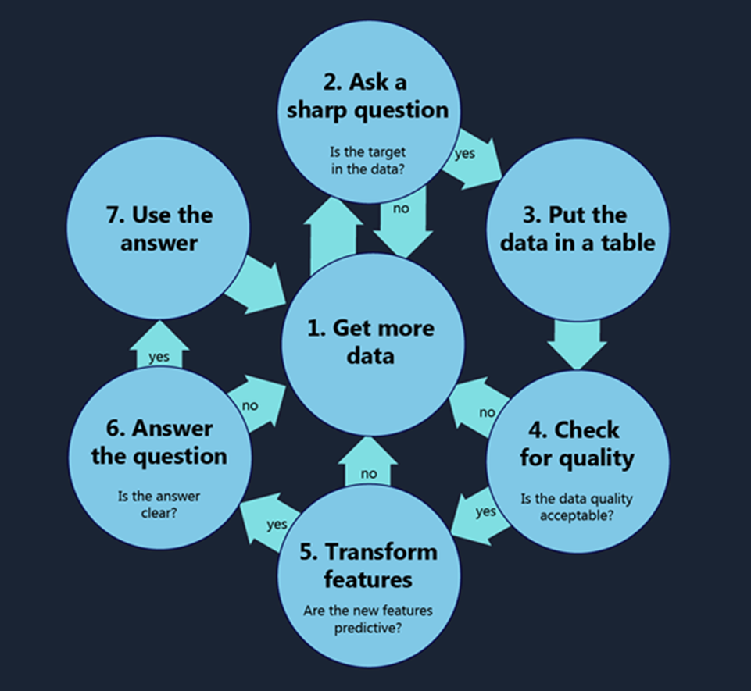
Data Science Process
https://blogs.technet.microsoft.com/machinelearning/2016/03/28/how-to-do-data-science/

Slide 4
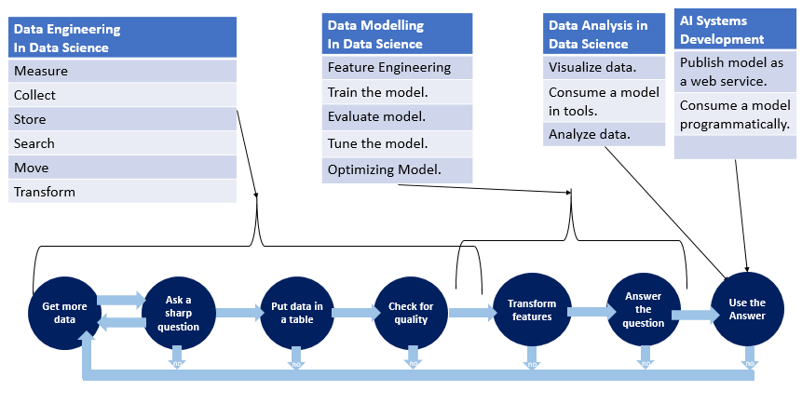
Mapping Data Engineering, Modelling and Analysis to Data Scientist Activities
* Credit to: Dr. Dzahar Mansor, National Technology Officer, Microsoft Malaysia

Slide 5
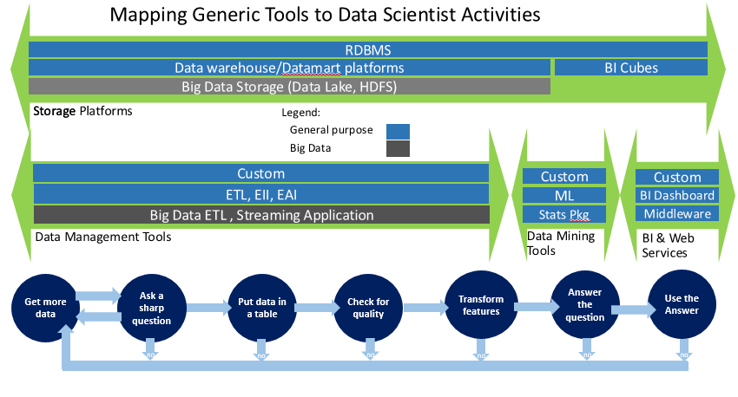
* Credit to: Dr. Dzahar Mansor, National Technology Officer, Microsoft Malaysia

Slide 6
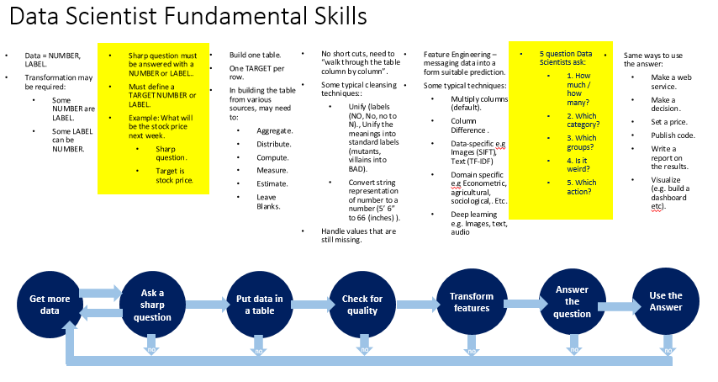
* Credit to: Dr. Dzahar Mansor, National Technology Officer, Microsoft Malaysia

Slide 7
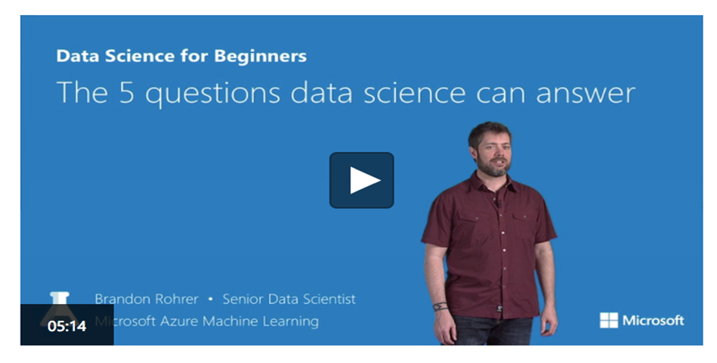
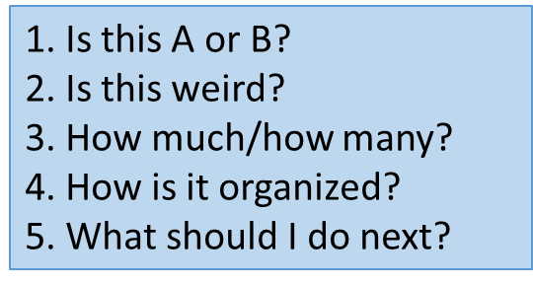
Asking A Question
Primary goal: To answer 5 types of questions using data – but to achieve and benefit from this, they also need to:
Prepare data to answer the 5 questions (Data Engineering, Feature Engineering).
To extract value on the answers from these 5 question (operationalizing data):
Predicting and forecasting.
AI/Intelligence/Cognitive applications.
https://azure.microsoft.com/en-us/resources/videos/data-science-for-beginners-series-the-5-questions-data-science-answers/
https://www.linkedin.com/in/brohrer/

Slide 8
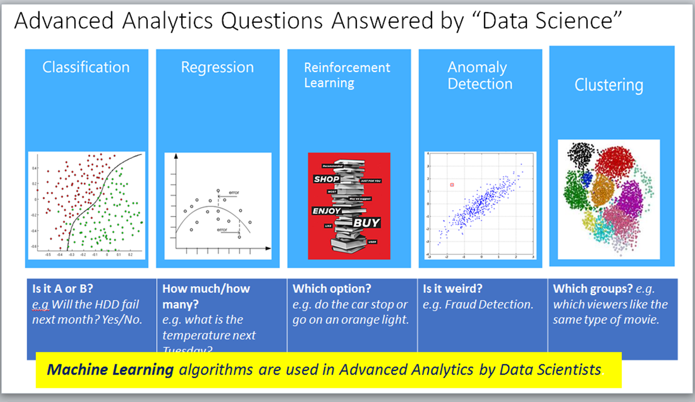

Slide 9
Recap – What Data Scientists Do
Ask questions in order to answer or solve known problems or find new solutions to problems with which businesses must deal.
Define data necessary for a particular need.
Work with existing data to collect, store and explore data.
Determine the needed analysis type for a particular situation or type of data.
Use algorithms and other tools to parse, clean, check quality and utilize data.
Transform insights learned into formats usable by non-data scientists (for use by others within the business), including the creation of graphs, charts, infographics and more.
Create software to automate data science tasks based on specific business requirements and data sources.

Slide 10
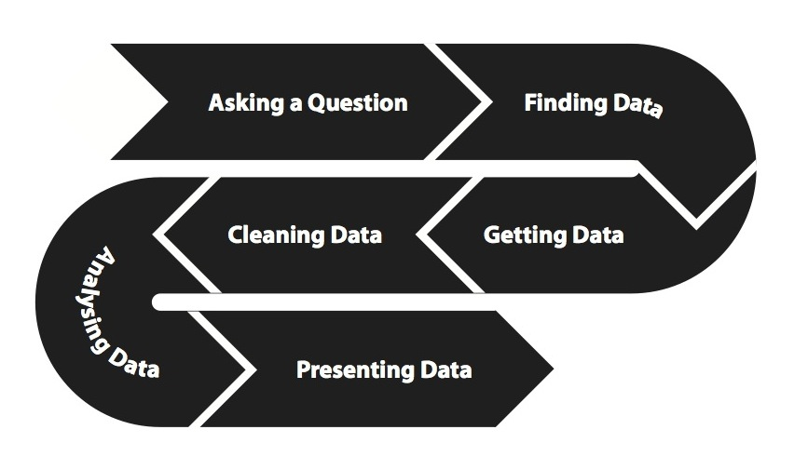
Data Processing Pipeline
http://okfn.booktype.pro/spending-data-handbook/getting-cleaning/

Slide 11
Data Processing
Almost all data processing involves the same set of incremental stages.
Acquisition. Data is gathered or new data is generated (e.g through a survey, observations, or experiments).
Extraction. Data is converted from whatever input format has been acquired (e.g. XLS files, PDFs, or even plain text documents) into a form that can be used for further processing and analysis. This often involves loading data into a database system like MySQL or PostgreSQL.
Cleaning and transformation. Errors, inconsistencies, and duplicates are removed from the data. You may also combine two different datasets into a single table at this stage.
Analysis. Data is analyzed to address the research question. We will not cover analysis in great detail in the Handbook—we assume that you are already the experts in working with your data and using e.g. economic models to answer your questions.
Presentation. The analysis of the data is presented in a form which is understandable to a particular audience and designed to achieve a particular outcome.

Slide 12

Big or Small? You need the RIGHT data
UBER success story
“The data may not contain the answer. The combination of some data and an aching desire for an answer does not ensure that a reasonable answer can be extracted from a given body of data …”
John Tukey (Wikiquote)
Uber’s success isn’t a function of the big data it collects.
That big data has enabled the company to enter new markets and fulfill new jobs in the lives of its customers.
Uber’s success results from something very different: the small, right data it needed to do something very simple — dispatch cars.
John Tukey (1915-2000)
American Statistician

Slide 13
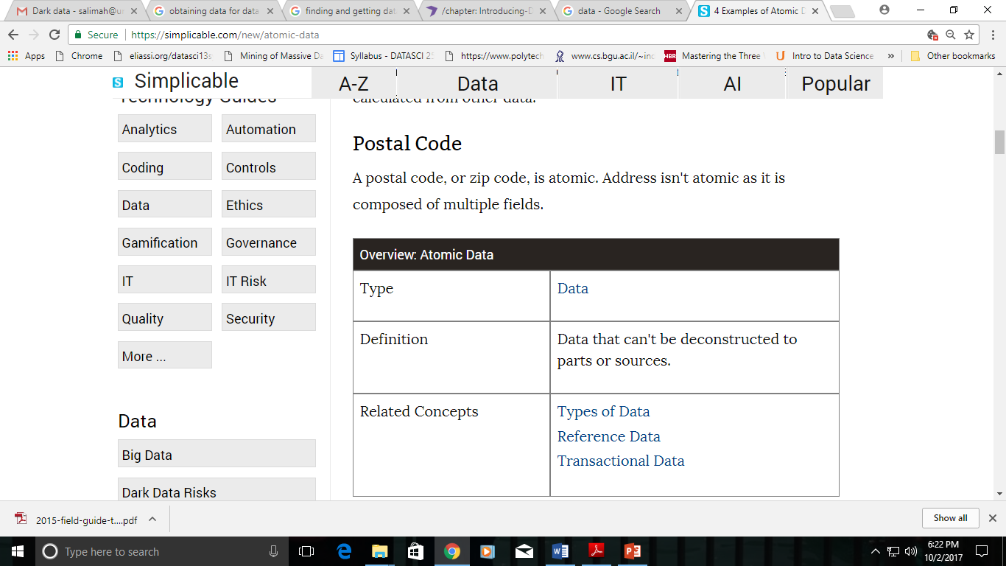
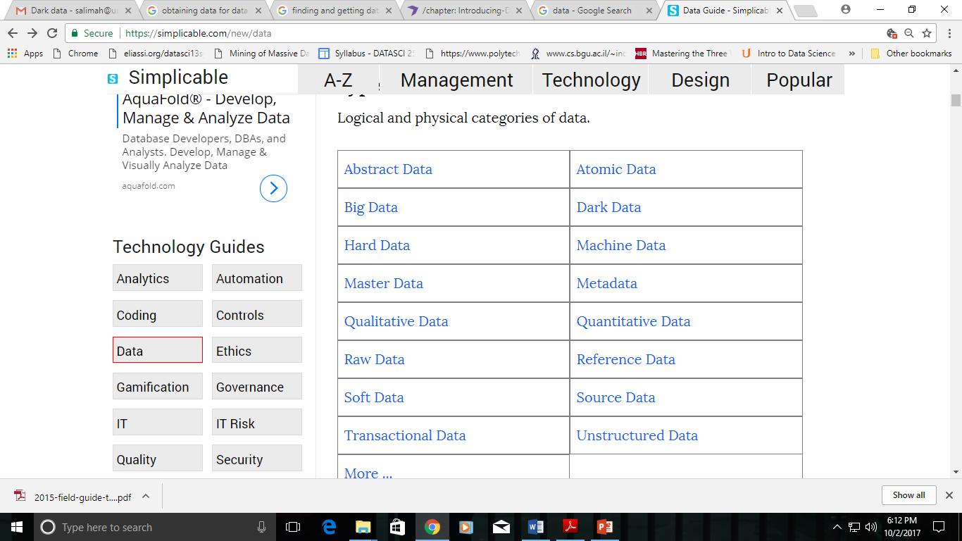
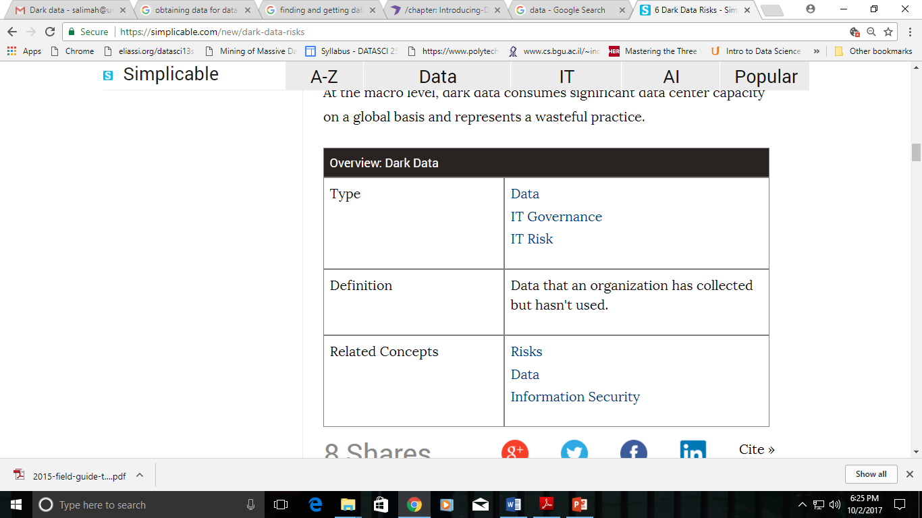
Data Literacy – Data Types
https://simplicable.com/new/data
Data based on an intuitive concept
Eg Base salary, unit sales, post codes
Data that is generated by machines without human involvement.
All About Data
Data that describes other data.
Data that is used to structure and constrain other data, typically stable information with a known set of values that rarely change.
A list of valid states for a country
Constants such as PI
List of valid months and days of the week
Business objects which are agreed on and shared across the enterprise
Data that hasn't be processed

Slide 14
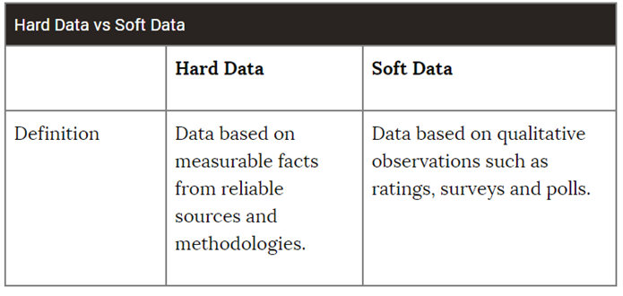
Data Literacy – Data Types
Qualitative data - everything that refers to the quality of something: a description of colors, the texture and feel of an object, a description of experiences, and an interview are all qualitative data.
Quantitative data - data that refers to a number, e.g. the number of golf balls, the size, the price, a score on a test, etc.

Slide 15
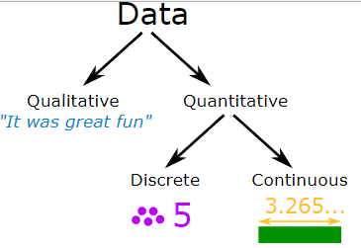
Data Literacy – Data Types
Categorical data puts the item we describe into a category.
For example, an item can categorized as “new”, "used" or “broken”.
Discrete data is based on counts. Only a finite number of values is possible, and the values cannot be subdivided meaningfully.
Examples are scores in tests, head count, shoe sizes or number of languages a person speaks.
Continuous data is numerical data with a continuous range. It can take any value (within a range).
Examples are a person's height (could be any value, within the range of human heights), weight of cars, speed of the train.
Counted
Measured

Slide 16

Unstructured vs. Structured Data
Data for Humans
A plain sentence – “we have 5 white used golf balls with a diameter of 43mm at 50 cents each” – might be easy for a human to understand, but for a computer, it is very difficult.
The above sentence is what we call unstructured data.
Unstructured data has no transparent underlying structure—it's impossible to mechanically figure out exactly what refers to what.
Likewise, PDFs and scanned images may contain information which is pleasing to the human eye as it is laid-out nicely, but they are not machine-readable or structured presentations of data.
Data for Computers
Computers are inherently different from humans. It can be exceptionally hard to make computers extract information from certain sources. Some tasks that humans find easy are still difficult to automate. For example, interpreting text that is presented as an image is still a challenge for a computer.
If you want your computer to process and analyze your data, it has to be able to read and process it. This means it needs to be structured and machine-readable.

Slide 17
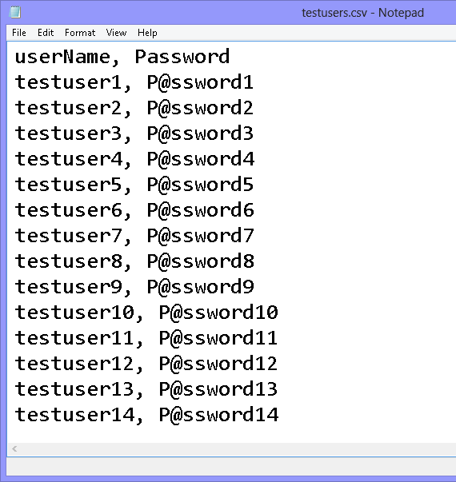
CSV
Most commonly used formats for exchanging data is CSV, which stands for "comma separated values".
It might look like this:
“quantity”, “color”, “condition”, “item”, “category”, “diameter (mm)”, “price per unit (AUD)”, 5,”white”,”used”,”ball”,”golf”,43,0.5
Data formatted like this is tabular data, data which forms a table consisting of rows and columns.
Think of each line in the CSV as a row, and think of each part of a line separated by a comma as part of a column.
Each row represents a single data item, and each column represents a property—the only exception is the first row, which gives the names of the columns.

Slide 18
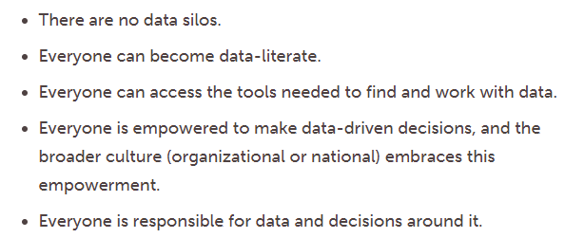
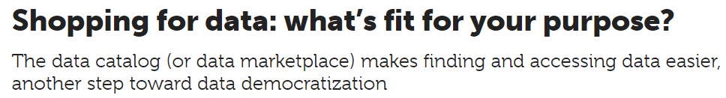
Finding Data
Searching and finding data that is readily available.
Data democratization is the idea that digital information should be accessible and understandable to the average end user as a basis for decision-making.
Aspirations behind data democratization
https://www.infoworld.com/article/3246632/database/data-democratization-finally-living-up-to-the-name.html

Slide 19

Finding Data
Once you know that what you want exists, it's time to hunt it down.
Is it freely available on the web? Check Google—you never know!
Or part of a package to which the library already subscribes?
Is it something we can buy? (And is it within the library's budget and can the purchase be made quickly enough to fit your timeframe?)
Can it be requested directly from the researcher? There’s a reason articles usually include author contact information
Think who might collect the data or who has the data.
Could it have been collected by a government agency?
An NGO or non-profit organization?
A private business or industry group?
Academic researchers?

Slide 20
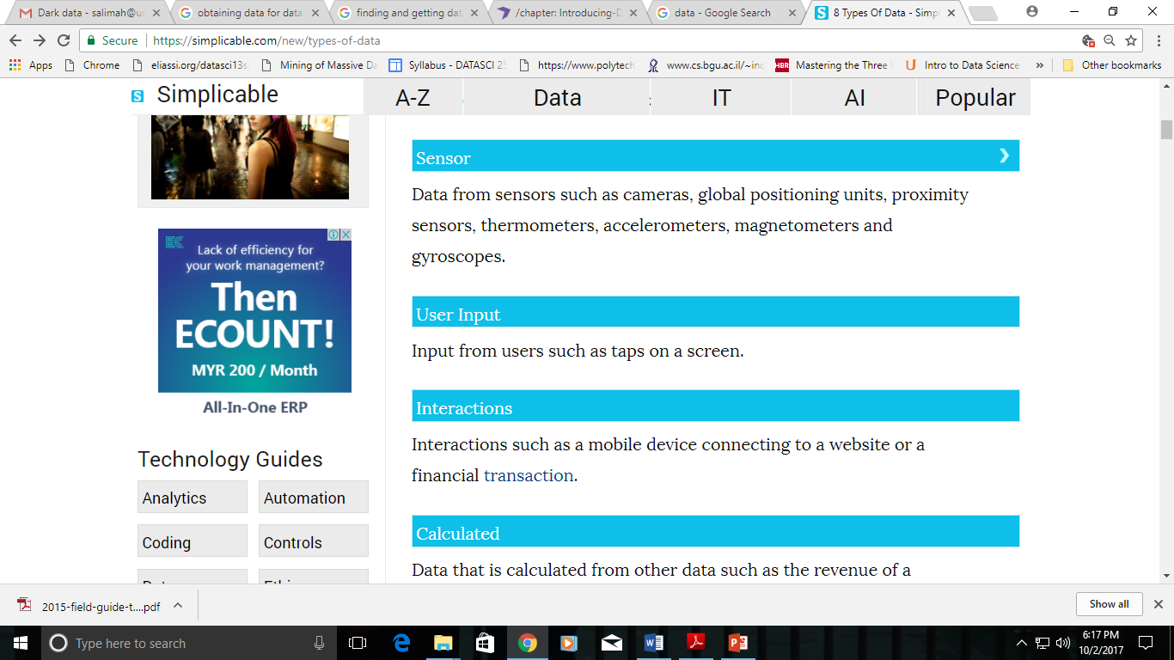

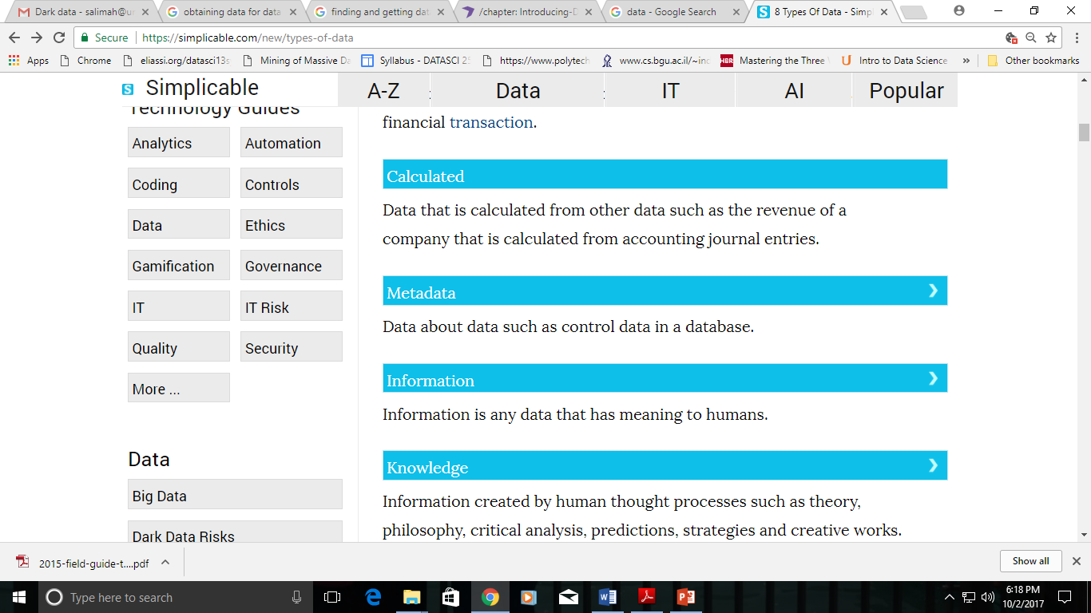
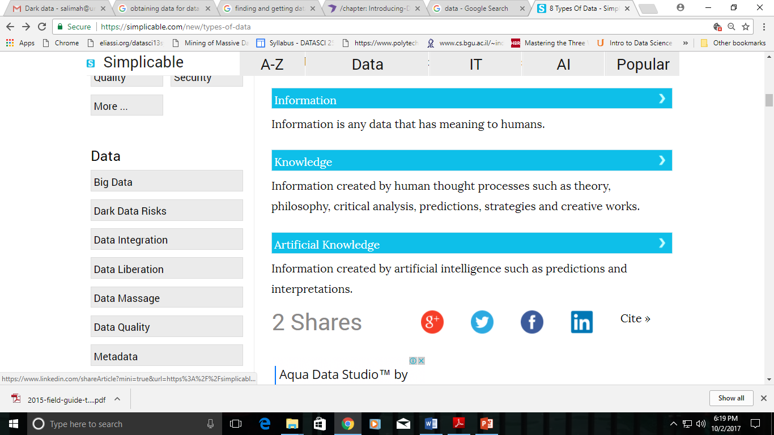
Sources of Data
Data is everywhere, created and used by just about anyone.
The Sensors which are used in the shopping complex to gather shopper information.
The posts which people make in social media platforms.
The digital pictures and videos we capture in our phone.
The purchase transaction which is made through e-commerce.

Slide 21
Raw Versus Processed Data
Raw Data
• Data from the original source
• Data that is often or difficult to be analyzed
• Data that needs to be processed before analyzing
• Usually raw data can be converted to processed data in one time.
Processed Data
• Data that is ready for analysis
• Processing can include merging, subsetting, transforming etc.
• There may be standards for processing
• All processing steps should be recorded.

Slide 22
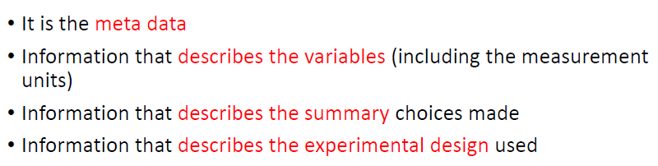
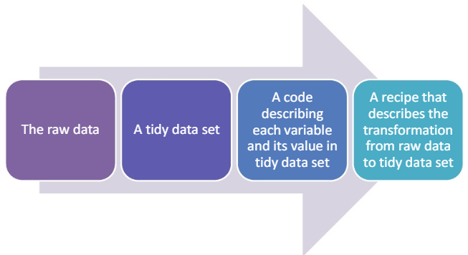
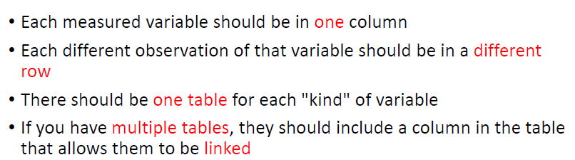
Data Processing
Explicit steps and exact recipe to get through 1 - 3 (instruction list)
•The programming script i.e. R script
•The inputfor the script –raw data
•The outputwill be the processed –tidy data set

Slide 23
Getting Data
Before you can even think about putting your data to work, you have to figure out how you’re going to obtain all the data you need.
Data is either collected (i) slowly over time as it becomes available to a database you set up, or (ii) downloaded from a source of curated datasets.
Data can be acquired for a data science project by many different means.
Some ways of acquiring data:
using data portals
submitting Freedom of Information requests
government cooperation
data scraping
use technology to bridge the gap between how information is shared and what is necessary for project.

Slide 24
Data Portals
Many countries have set up dedicated open data portals.
published datasets and relevant metadata
Two indexes : The Open Data Census and datacatalogs.org
The Guardian also provides a world government data search engine.
Comparative data - available from the data portals of the United Nations, World Bank, and World Health Organization.
A lot of government data is indexed by ordinary web search engines.
The trick to finding this data is anticipating its file format. If you limit your searches to machine-readable file formats specific to the type of data you want (e.g. CSV or XLS for tabular data, SQL or DB for databases), your search results are likely to be relevant data.
Add "+filetype:extension" to your Google query to look for files with a specific extension, e.g. "+filetype:csv" to look for CSV files.
Check the Open Knowledge Foundation's Data Hub, "a community-run catalogue of useful sets of data on the Internet", to see if anyone else has put up the data you're looking for.

Slide 25
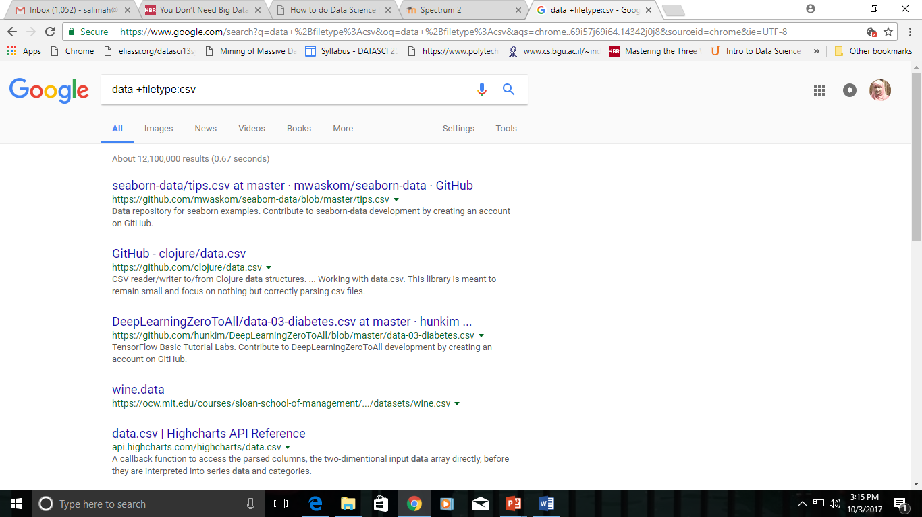
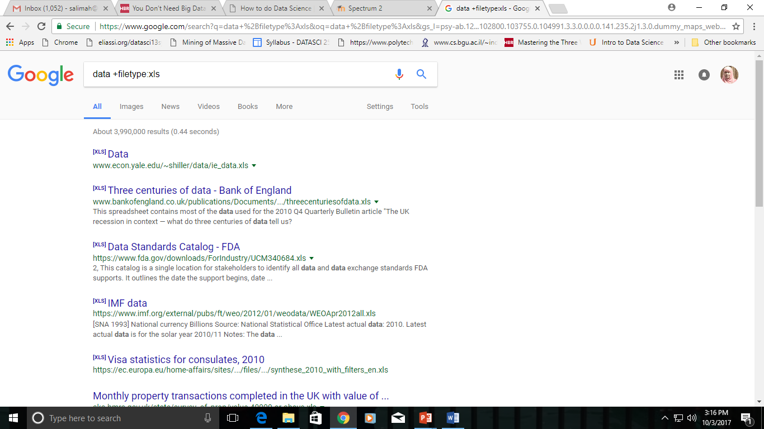

Slide 26
Open Data
Open data is data that is made freely and easily available to anyone to use, reuse and distribute.
The Open Knowledge Foundation, an organization dedicated to bringing “openness” to the mainstream, defines the following key factors that make data “open”:
Access & availability - data is available to all in a convenient and modifiable form
Re-use & redistribution - terms of use allow for reusing, remixing and redistributing the data
Universal participation - there are no restrictions on who may do any of the above with the data
Similarly, the FAIR research principles advocate for Findable, Accessible, Interoperable, and Reusable data.
https://mozillascience.github.io/open-data-primers/1-open-data-what.html

Slide 27
Free: Datasets List
https://elitedatascience.com/datasets
https://www.kaggle.com/datasets
https://www.dataquest.io/blog/free-datasets-for-projects/
https://archive.ics.uci.edu/ml/datasets.html

Slide 28
APIs
Open data is sometimes provided through an application programming interface (API).
This is a web-based method for retrieving, searching, or even updating data dynamically from within a programming language environment.
APIs provide up-to-date data in a granular and filtered form, removing the need to repeatedly process and update source files.
A common use case for APIs is relatively time-sensitive information, such as procurement calls and contracts which are released every day.
Application Programming Interface (API): a specification allowing two pieces of software to interface with each other, without either having knowledge of the inner workings of the other.

Slide 29
Freedom of Information (FOI)
Many countries decided to increase the transparency of their governments by introducing Freedom of Information (FoI) legislation.
Laws - enable every citizen to request documents and other material from parts of the government which do not merit special protection (e.g. due to concerns over privacy, national security, or commercial confidentiality).
FoI requests may be necessary when you want to get more detail on the projects that government money is funding.
A good example of this process is the Sunlight Foundation's request for information on the Airport Improvement Program in the United States.
If you see some interesting patterns in your high-level spending data, don't be afraid to dig deeper and ask for more detailed program information.

Slide 30
Preparing FOI request
Want to submit an FoI request, but not sure where to start, who to address your request to, or how to write it? Access Info is an organization that works to help people obtain the information they require from the public bodies that hold it. They have also produced a toolkit for FoI requests. It's primarily aimed at journalists, but most of the tips are equally relevant for other researchers.
Before submitting your FoI request, consider whether you could acquire the data by some other route. Journalists, activists, and CSOs have long had their own channels of acquiring information. Sometimes having a good relationship with a press officer or a civil servant is good enough, and making a formal request for information is unnecessary—your friendly press-officer may even feel offended if you don't ask them nicely first. FoIs generate a lot of paperwork (hence grumpy civil servants), so if you do have the contacts, it may be a good idea to ask nicely first!
If an FoI request is your best option, make sure to invest some preparation in formulating your request. The documents or databases that are requested should be clearly identified, you should be aware of the department or unit in charge of the request, and you should address possible concerns over privacy or commercial confidentiality in your request.
Don't count on receiving data in a machine-readable form. The FoI legislation in force in many countries was established before the need for structured data became apparent, and many laws do not allow the citizen to request a particular format. Many governments choose to release information on paper rather than in a structured digital form, which makes the data processing step more painful.

Slide 31
Data Scraping
Scraping refers to transforming unstructured documents (online database interfaces, PDF files, or even printed documents) into a structured form that is ready for computational processing and analysis.
Although many easy-to-use scraping tools which do not require much technical know-how exist, many of the most rewarding data scraping tasks – such as the automated scraping of thousands or millions of web sites or the mass interpretation of PDF files – require some programming ability.
Start learning about what data scraping is, with ScraperWiki (now renamed as QuickCode, https://quickcode.io/ )

Slide 32
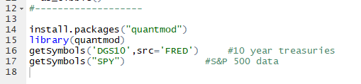
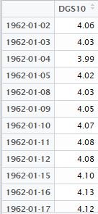
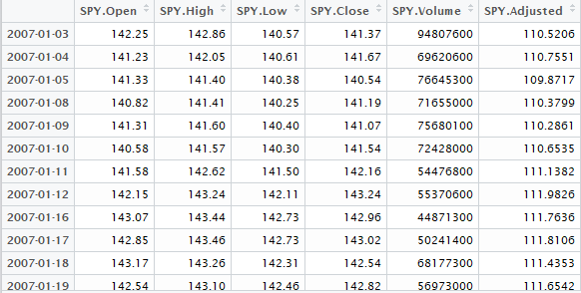
Examples of Web Scraping
Web scraping is a technique employed to extract data from a website.
Source: http://www.programmingr.com/examples/webscraping-stock-prices-economics-data-r/

Slide 33
Getting Data Out of Scanned Documents
In some cases, the only way to gain access to a dataset is through the digitization of printed material.
How to leverage data which is trapped inside scanned documents and images?
Optical character recognition (OCR) software is built to do this, accepting scanned pictures and PDF documents as an input.
ABBYY FineReader, and some open-source software packages, such as Google's Tesseract.
Automated data entry solutions do a great job of reading scanned documents and images and then transferring that data into a different format such as excel sheet or csv.
https://docparser.com/blog/extract-data-scanned-documents-images/

Slide 34
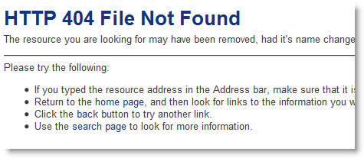
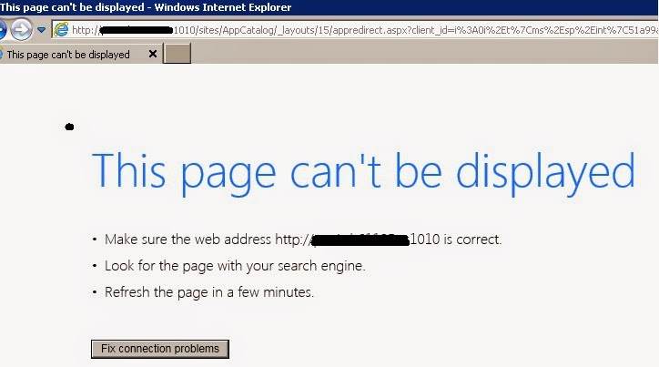
Keeping the Data Around
Experience has shown that data does disappear, whether through the government redesigning its web sites, new policies that retract transparency rules, or simple system failures.
Help prevent the disappearance of data by keeping your own archival copies.
For data found on the web, this means downloading complete copies of web sites – a process called mirroring – which is a fairly well established technique that can easily be deployed by civil society organizations and other researchers.
Mirroring involves using a computer program called a web crawler to harvest all the web pages from a specified web page, e.g. a ministry home page.
Also possible to find old versions of web sites via the Internet Archive's Wayback Machine, a project that aims to create up-to-date copies of all public web sites and archive them forever.

Slide 35
Downloading files
Always check and set your working directory using the getwd( ) and setwd( ) commands
To check whether the “Data” directory has been created or not:
if (!file.exists("data")){
dir.create("data")
}

Slide 36
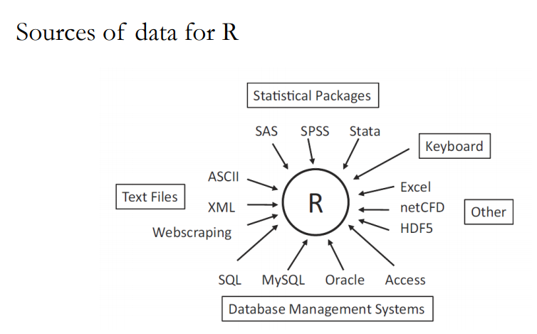

Slide 37
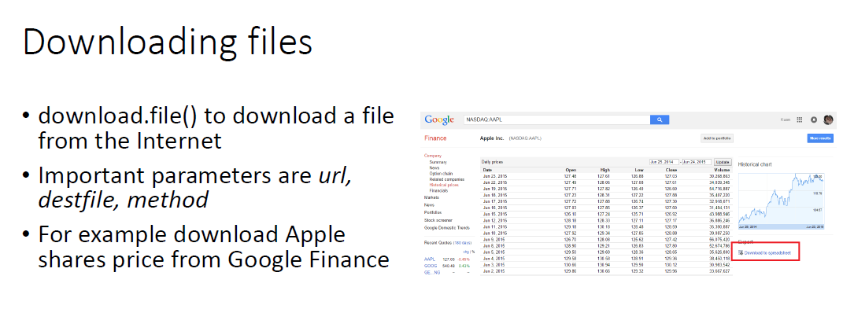
fileURL<-"https://www.google.com/finance?q=NASDAQ%3AAAPL&ei=ykGKVaPlPMSsugS66bOIAw"
download.file(fileURL, destfile=("./data/apple.csv"))
list.files("./data")

Slide 38

Exercise 1
Try out these Ex.1 – Ex.10 using R.
No need to submit on Spectrum
Download the data for “JUMLAH PERGERAKAN PESAWAT PERDAGANGAN YANG DIKENDALIKAN MENGIKUT LAPANGAN TERBANG, MALAYSIA, 2013” from this URL http://www.data.gov.my/data/ms_MY/dataset/2f7fb63c-feeb-41a2-9f6f-9b869e13bb01/resource/b198057c-99a2-4d1e-ba6c-d2bcef6bdf0a/download/pergerakan-pesawat-perdagangan-mengikut-lapangan-terbang-2013.xlsx
Store in comflight.xlsx file

Slide 39
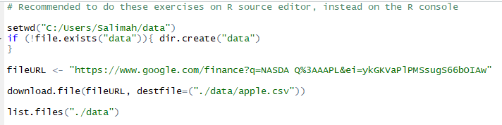
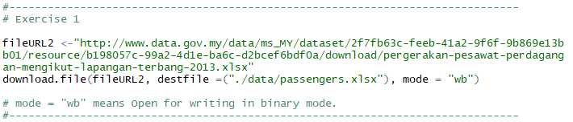
Exercise 1 – Try this

Slide 40
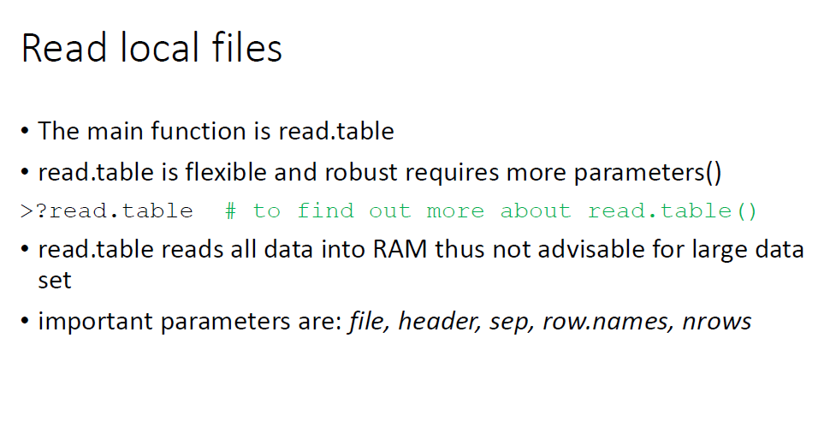

Slide 41

Exercise 2
Read file with “,” as delimiter
>comma_dat<-read.table("http://bit.ly/1e9Cvzu", header=TRUE, sep=",")
Read the test_semicolon.txt with “;” delimiter file from http://bit.ly/1RGbPn9 and store in semi_dat
Show the content of semi_dat
Try create a csv file using the data below and repeat the above using this file.
gender,id,race,ses,schtyp,prgtype,read,write,math,science,socst
0,70,4,1,1,general,57,52,41,47,57
1,121,4,2,1,vocati,68,59,53,63,61
0,86,4,3,1,general,44,33,54,58,31
0,141,4,3,1,vocati,63,44,47,53,56

Slide 42
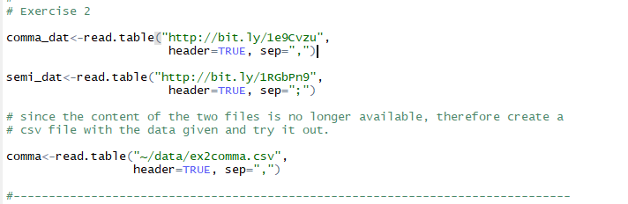
Exercise 2 – Try this

Slide 43
Exercise 3
Download the “Genting Malaysia Berhad” share prices (in csv) from Yahoo! Finance (URL: https://finance.yahoo.com/quote/4715.KL/history?period1=1506856572&period2=1538392572&interval=1d&filter=history&frequency=1d)
Store in genting.csv file
Read the file and describe the data obtained:
Number of observations
Number of Variables
Names of the variables
Calculate average closing price
Calculate number of days where the closing price is more than RM 1.35

Slide 44
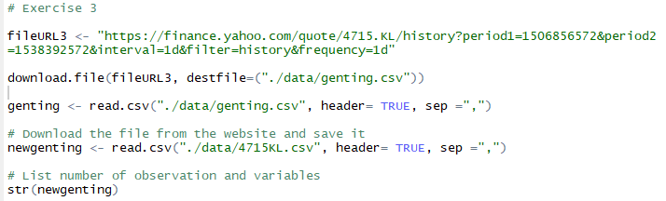
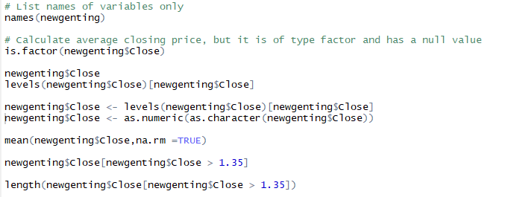
Exercise 3 – Try this

Slide 45
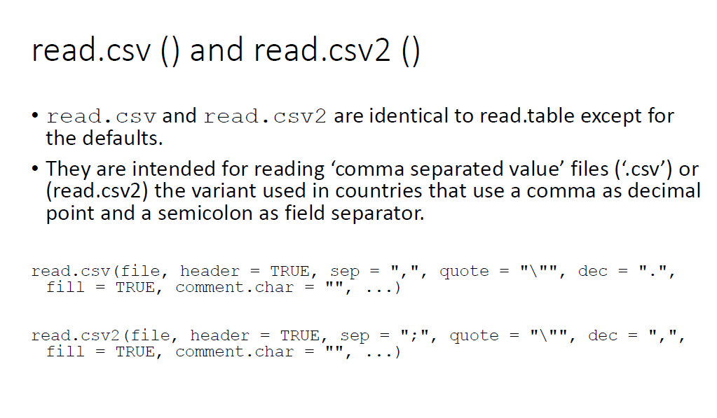

Slide 46
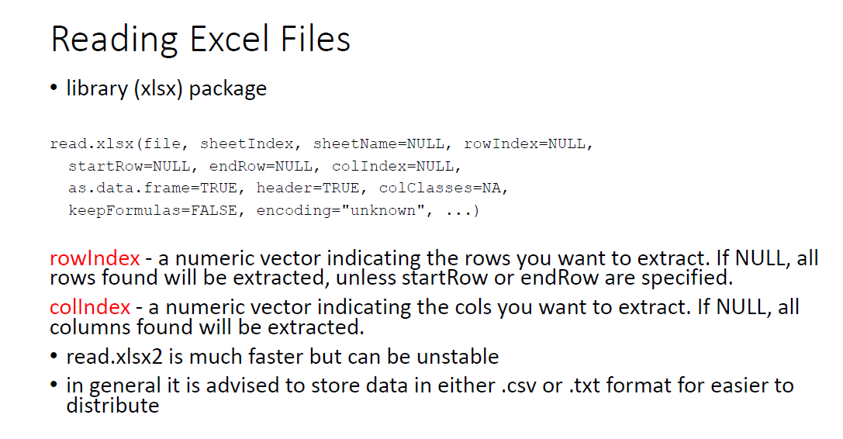

Slide 47
Exercise 4
Download the Excel spreadsheet on Natural Gas Acquisition Program here:
https://d396qusza40orc.cloudfront.net/getdata%2Fdata%2FDATA.gov_NGAP.xlsx
Read rows 74 to 79 and columns 14 to 21 into R and assign the result to a variable called: xlsdat
Calculate the sum for Supp_Vol* Supp_Org_Cost

Slide 48
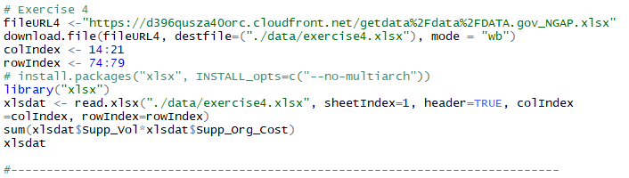
Exercise 4 – Try this

Slide 49
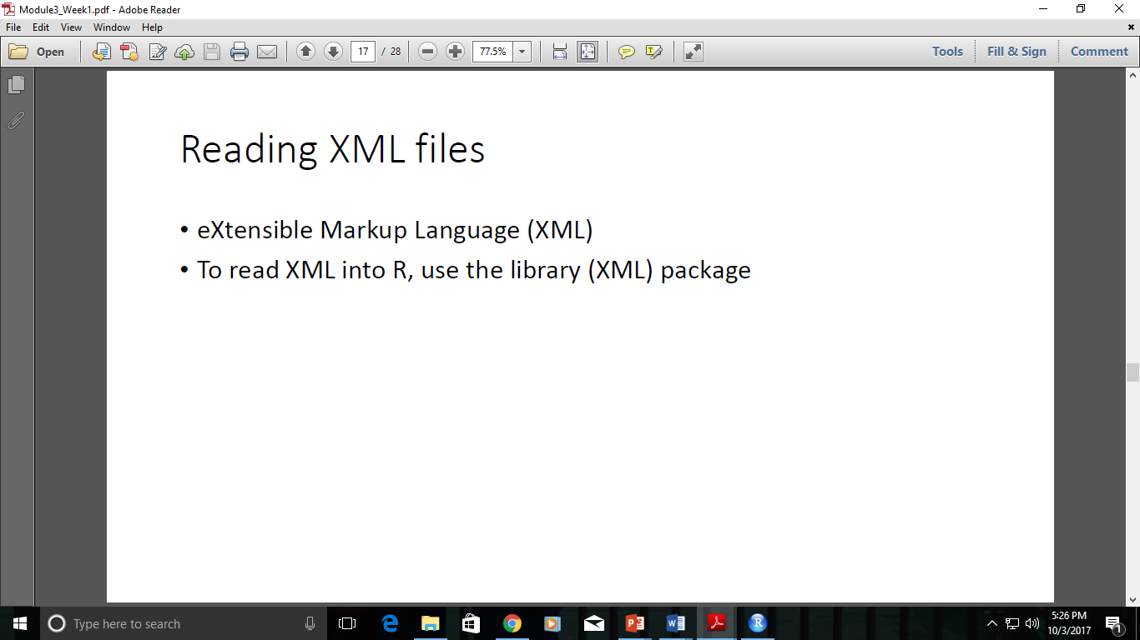
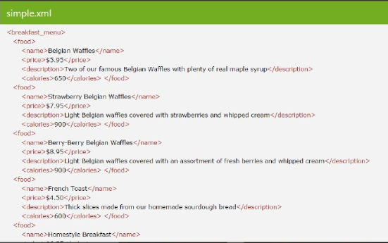
Frequently used to store structured data
Particularly widely used in Internet applications
Extracting XML is the basis for most web scraping
Components
markup -labels that give the text structure
Content -the actual text of the document

Slide 50
Exercise 5
Read Kuala Lumpur weather forecast data from here
http://www.yr.no/place/Malaysia/Kuala_Lumpur/Kuala_Lumpur/forecast_hour_by_hour.xml
Calculate the average temperature for the day.

Slide 51
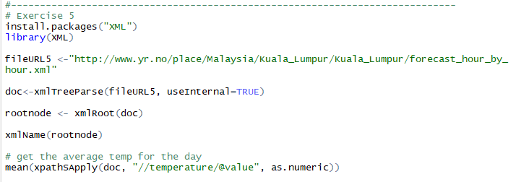
Exercise 5 – Try this

Slide 52
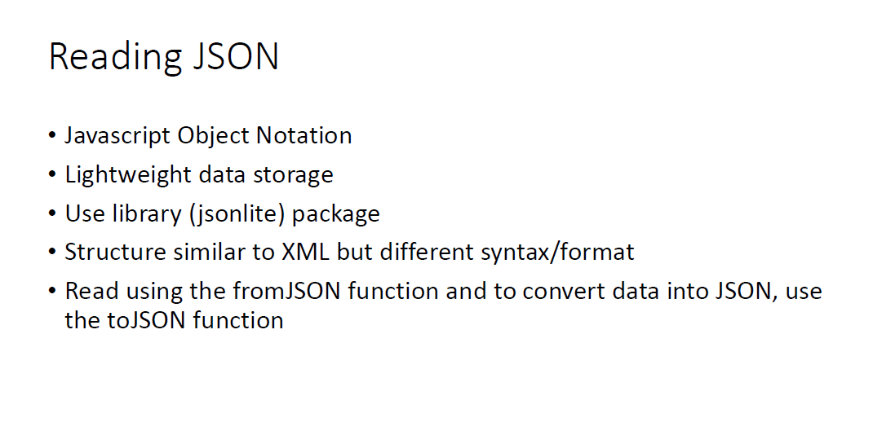

Slide 53
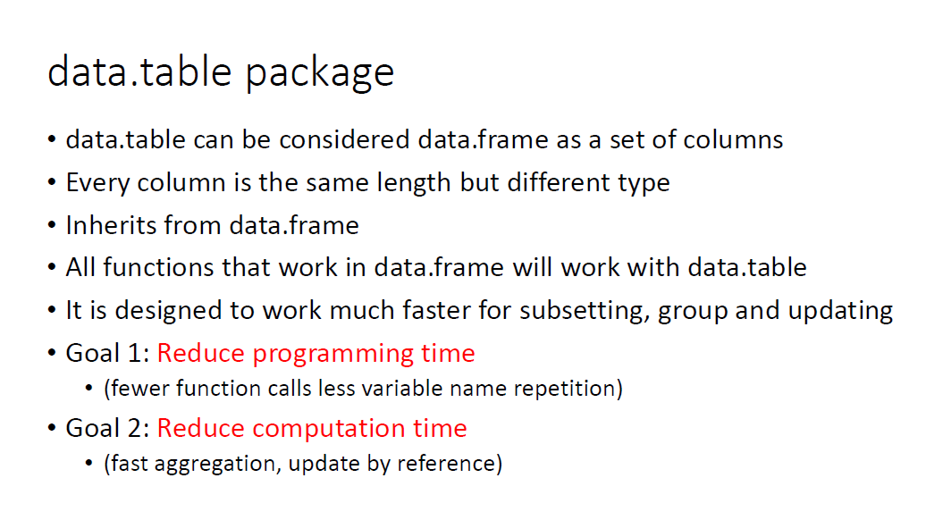

Slide 54
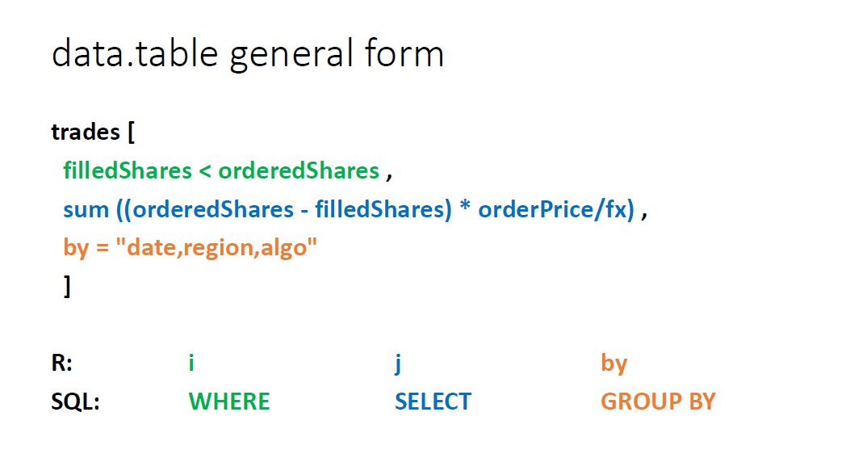

Slide 55
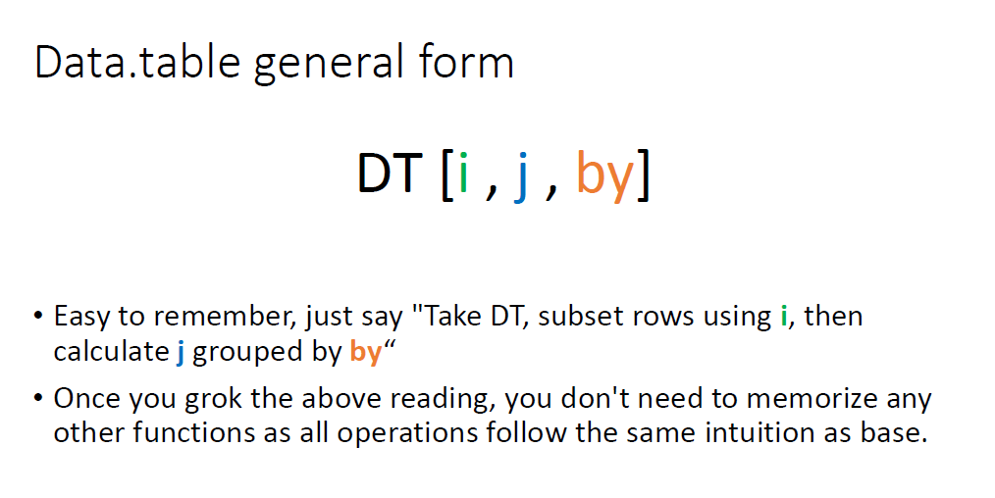

Slide 56
Exercise 6
Compare both data.frame and data.table
> DF <-data.frame(x=rep(c("a","b","c"),each=3), y=c(1,3,6), v=1:9)
> DT <-data.table(x=rep(c("a","b","c"),each=3), y=c(1,3,6), v=1:9)
Notice the output differences for both DT and DF
Check the class for both DF and DT
Subsetting rows: Select row 3 to 5 and the output for DF and DT
Show all the records where x==a
Show records for rows 1,3,7 for both DF and DT

Slide 57
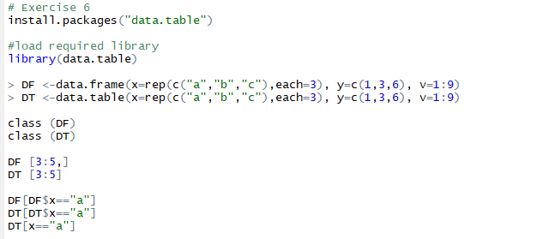
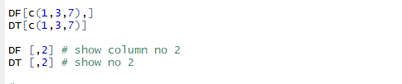
Exercise 6 – Try this

Slide 58
Exercise 7 (Computing on Columns)
The subsetting function is modified for data.table
the argument passed after the comma is called an "expression“
Examples
>DT[,list(mean(y), sum(v))]
>DT[,.(length(x), sum(y))] # .() is same as list()
Find the max for column y and mean for column v
Find the square root of column y and store in column w, show all the elements in w
Find the mean of column v and store in column w

Slide 59

Exercise 7 – Try this

Slide 60
Exercise 8 (multiple operations)
Performs any expression on j
Example:
>DT[,plot(y,v)]
>DT[,for(x in 1:10) print(x)]
Plot the histogram for y and find the log value for elements in column v and store in a variable called temp and in column z

Slide 61

Exercise 8 – Try this

Slide 62
Exercise 9 (Doing j by group)
Get the sum of v and group them by column x
> DT[,sum(v),by=x]
Calculate the mean for column y and group the result by even and odd rows

Slide 63

Exercise 9 – Try this

Slide 64
Exercise 10 (Performance Analysis)
> library(datasets)
Load the iris data set, convert it to data.table called irisDT
Get the mean for Sepal.Width and group the results by Species
Determine the time to compute mean for Sepal.Length group by Species
Find the computation time for the followings:
>system.time(mean(irisDT$Sepal.Length,by=DT$Species))

Slide 65

Exercise 10 – Try this

Slide 66
What exactly are the reported times user, system, and elapsed?
User CPU time gives the CPU time spent by the current process (i.e., the current R session)
System CPU time gives the CPU time spent by the kernel (the operating system) on behalf of the current process.
Elapsed is the wall clock time taken to execute the function

Slide 67
Tutorial 2
Web Scraping with R
Try out the following tutorial:
https://medium.freecodecamp.org/an-introduction-to-web-scraping-using-r-40284110c848
Show that you had successfully done some web scraping.
You may use the “Scrape product details from Amazon” (mentioned above) or any other example that you find online.
Submit on Spectrum for Tutorial 2, latest by 11 October 2019.

Slide 68

References
John Spacey, Data Guide
http://okfn.booktype.pro/spending-data-handbook/getting-cleaning/
https://r-dir.com/reference/datasets.html
https://www.springboard.com/blog/free-public-data-sets-data-science-project/
http://kek.ksu.ru/eos/WM/AutDataCollectR.pdf

